Slide 1

Santander Transaction Prediction
Cloud Computing
Xiaotian Huang, Wenyu Zeng

Slide 2
Scope of the Project
Banco Santander, S.A., is a Spanish multinational commercial bank and financial services company based in Madrid and Santander in Spain.
The bank is finding ways to help customers understand their financial health and identify which products and services might help them achieve their monetary goals.
The goal for this project is to predict whether a customer will make transaction, irrespective to the amount of money, in the future.
By using the AWS products to store and access the dataset, we will build models and generate graphs in jupyter notebook

Slide 3
Data Processing and Expected Outcomes
Dataset found in Kaggle competition.
200,000 entries and 202 columns.
Since this is a classification problem, we plan to use Naive Bayes, Logistic Regression and Random Forest models to predict the target class. By comparing the accuracy of each model, we will then select the best model among them.

Slide 4
Project Architecture

Slide 5
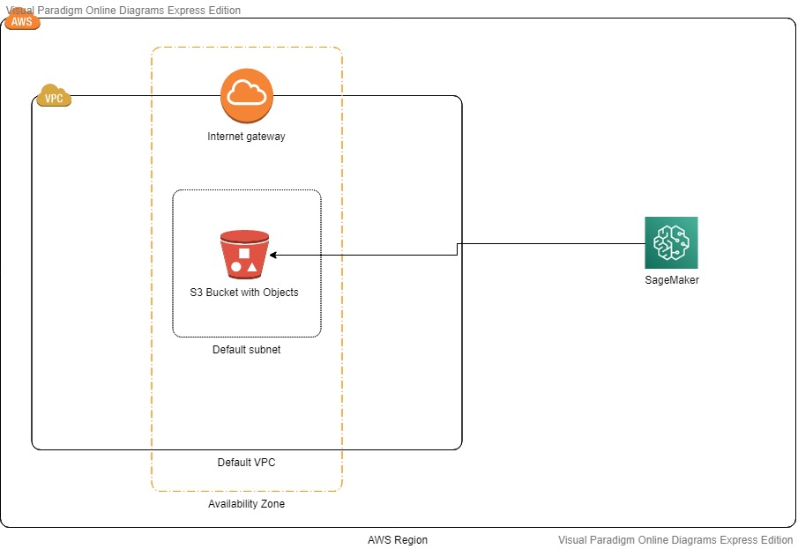



Slide 6
Models

Slide 7
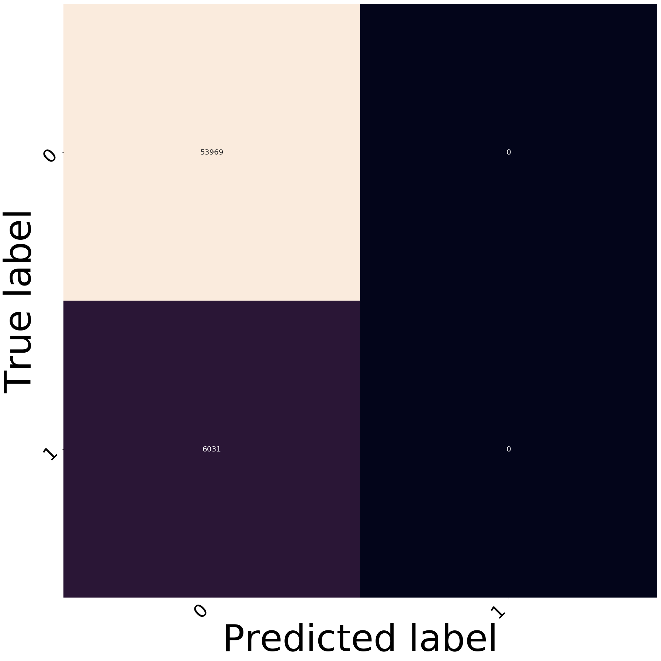
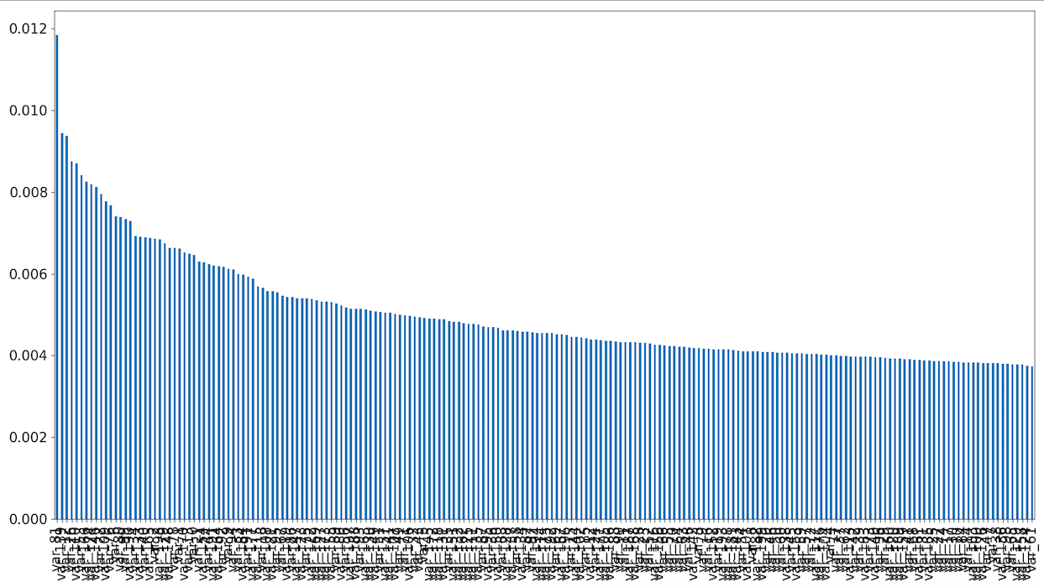
Random Forest

Slide 8
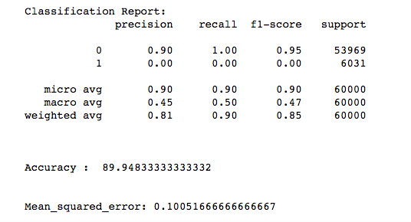
Random Forest

Slide 9

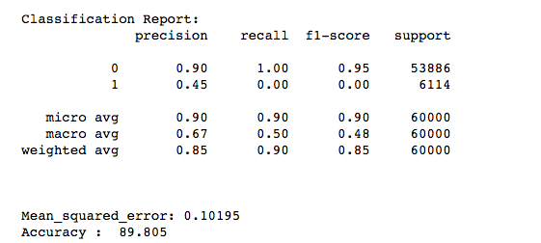
Naive Bayes

Slide 10
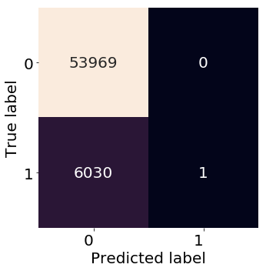
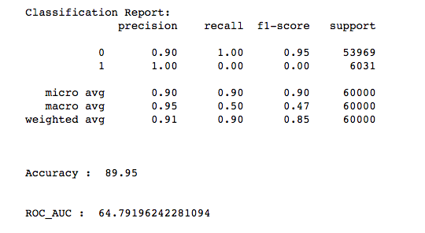
Logistic Regression

Slide 11
Demo

Slide 12


Slide 13
References:
https://en.wikipedia.org/wiki/Banco_Santander
https://www.kaggle.com/c/santander-customer-transaction-prediction/overview
https://www.kaggle.com/gpreda/santander-eda-and-prediction
https://online.visual-paradigm.com/w/anbcroxt/drive/#diagramlist:proj=0&new=AWSDiagram

